Slide 1
PDSMJZG565: Machine Learning Introduction
Session1
Aakash Goel , https://www.linkedin.com/in/goelaakash123/
Acknowledgment: Presentation developed by Prof. Arun. and Modified by Aakash Goel

Slide 2
Agenda
1
Course flow
2
What is ML
3
WHY ML
3
Types of ML predictions

Slide 3
Topics
90% of the problems in MFG shall be solved using the following:
Linear regression
Logistic regression
Clustering
Anamoly Detection
Dimensionality reduction
10%
Neural networks for Linear and logistic regression
Computer vision
Chatbots GenAI

Slide 4
Course flow
Lab session after 3rd session
First Quiz after 8th session
Situational learning (project) after 10th Session)
Second Quiz after 16th session
First session
Theory assignment after 7th session
Midsem Exam
Lab assignment after 12th session
Compre exam

Slide 5
Course flow
Linear Regression :Evaluation
Refresh the Python
Logistic Regression Intro
Clustering Models and Evaluation
Theory Assignment before midsem
Quiz before midsem
1
2
3
4
5
6
7
8
Theory Assignment before midsem
First session
Linear Regression :Intro
Linear Regression :Evaluation
Logistic Regression Evaluation
Anomaly Detection
Model Deployment
CNN
Chatbot and GenAI
Quiz after midsem
9
0
1
2
3
4
5
6
Situational learning assignment (small project)
Lab
Situational learning assignment (small project)
Lab
PCA
Edge Computing
Introduction to NN
RNN and Computer Vision

Slide 6
Where have you seen ML being mentioned in your plant/factory environment?
https://www.youtube.com/watch?v=6eGwbxHOa-A&ab_channel=FaststreamTechnologies

Slide 7
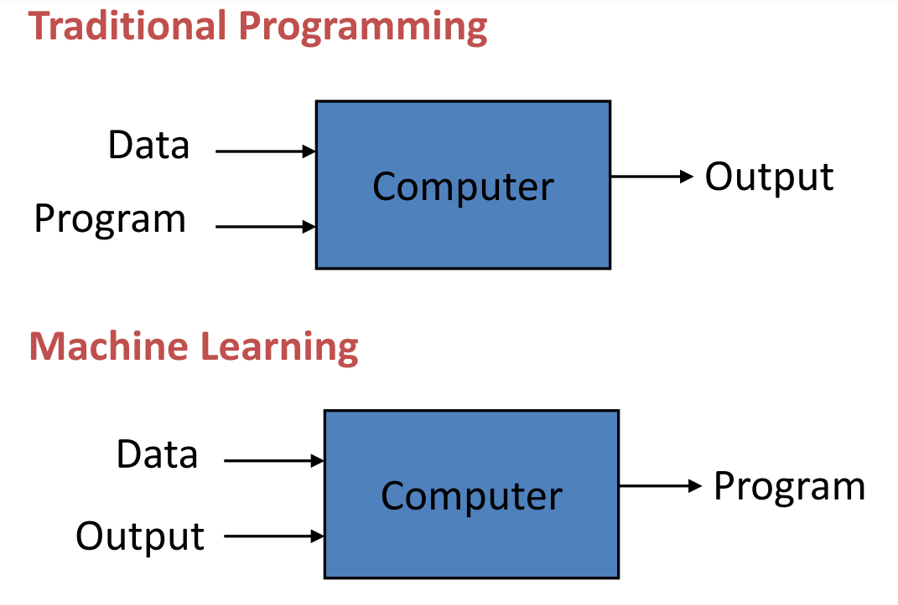
Machine learning: What is ML?
Think of a new intern on your factory floor. You don’t give them a list of rules to detect defective products — instead, you show them good vs bad parts until they learn the pattern. That’s ML.
"Machine Learning is a field where we teach machines to learn patterns from data without explicitly programming every rule."

Slide 8

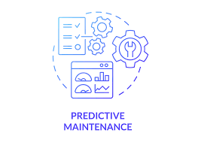

Machine learning:
Quality Control:
Use AI/ML to analyze sensor and camera data.
Detect defects and anomalies in steel products.
Ensure consistent product quality and reduce waste.
Predictive Maintenance:
Analyze sensor data and maintenance records.
Predict equipment failures and maintenance needs.
Schedule maintenance proactively to reduce downtime and optimize costs.
Process Optimization:
Utilize data from sensors, production records, and external factors.
Identify patterns to improve energy efficiency and reduce material waste.
Enhance overall process performance.

Slide 9



Machine learning:
Supply Chain Optimization:
Analyze demand forecasts, inventory levels, transportation routes, and pricing data.
Make informed decisions on production planning, inventory management, and logistics.
Achieve cost savings and improve customer satisfaction.
Energy Management:
Analyze energy consumption data.
Identify opportunities for energy optimization.
Reduce costs, improve sustainability, and comply with environmental regulations.
Demand Forecasting:
Analyze historical sales data, market trends, and other factors.
Forecast future demand for steel products.
Optimize production planning, inventory management, and pricing strategies.

Slide 10
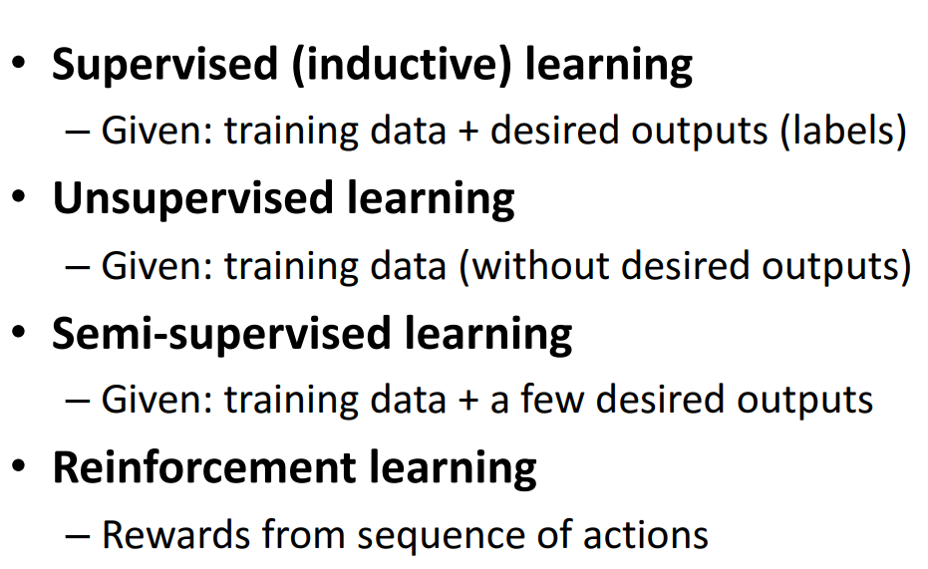
Machine learning:

Slide 11


Slide 12
Name | Approximate Length (mm) | Approximate Diameter (mm) | Type of Component | Additional Notes
Bolt (Hex Head) | 50-150 | 6-12 | Fastener | Threaded with a hexagonal head
Nut (Hexagonal) | 5-20 | 6-12 | Fastener | Matches with bolts
Washer | 2-5 | 6-12 | Spacer | Flat circular shape
Open-Ended Wrench | 100-250 | N/A | Tool | Fits hexagonal heads
Screw | 10-50 | 4-8 | Fastener | Threaded with a flat or cross head
Allen Bolt | 20-70 | 5-10 | Fastener | Requires an Allen key for tightening
Spacer | 5-20 | 6-15 | Support | Used between components
Socket Head Bolt | 25-80 | 6-10 | Fastener | Requires a socket wrench
Lock Washer | 3-6 | 6-12 | Locking Component | Serrated or split design
Small Nut | 3-5 | 4-6 | Fastener | Smaller-sized hexagonal nut

Slide 13
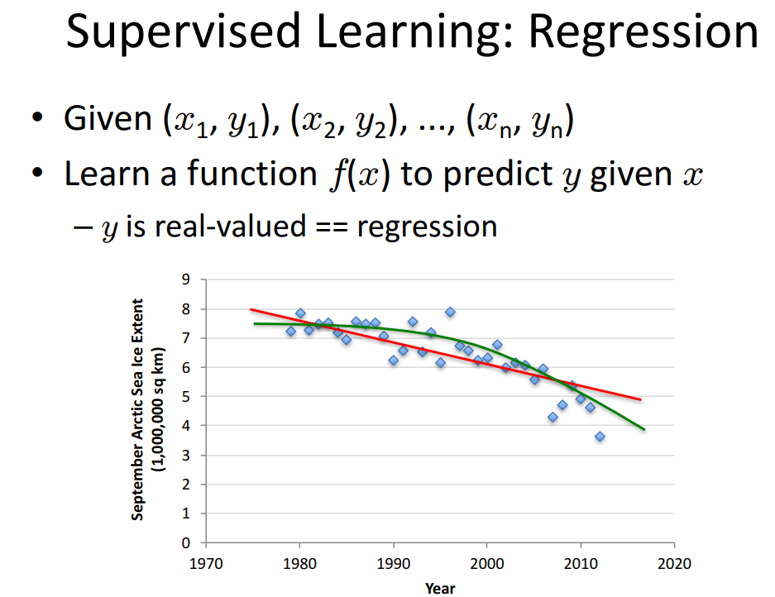
Machine learning:

Slide 14
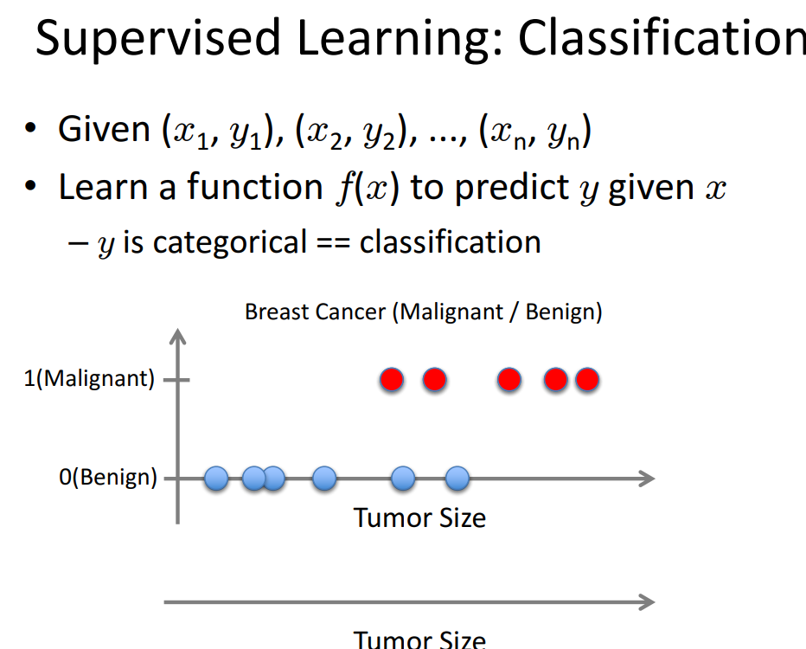
Machine learning:

Slide 15
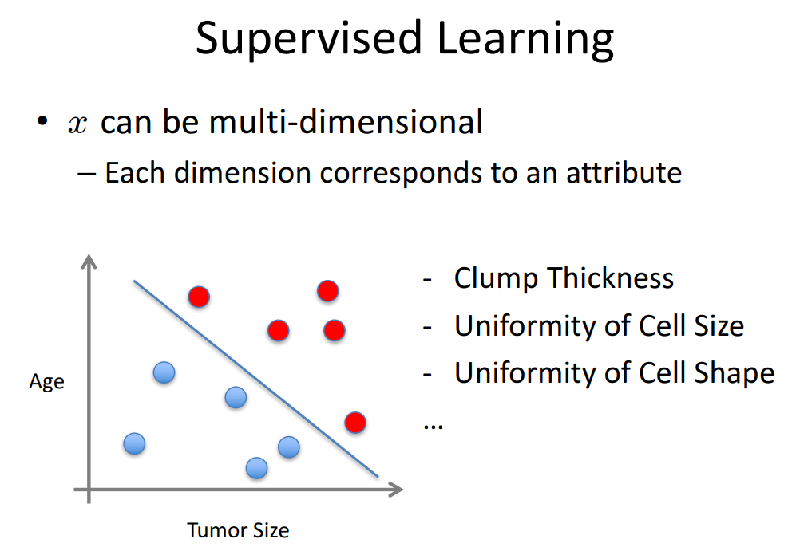
Machine learning:

Slide 16
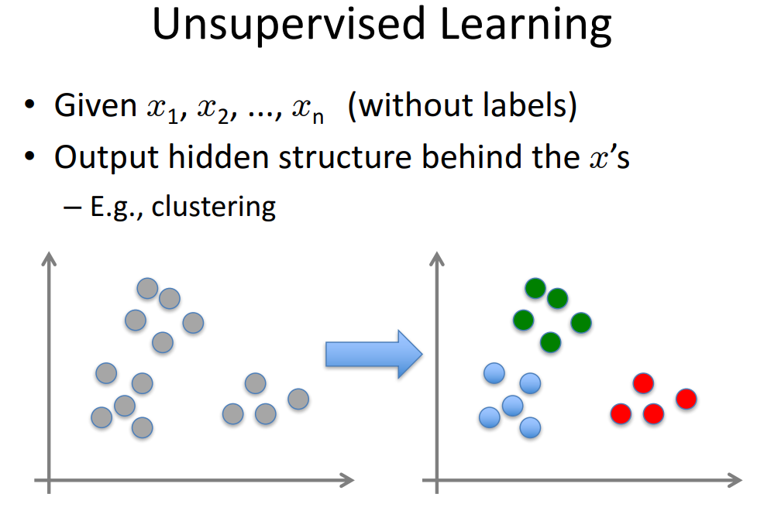
Machine learning:

Slide 17
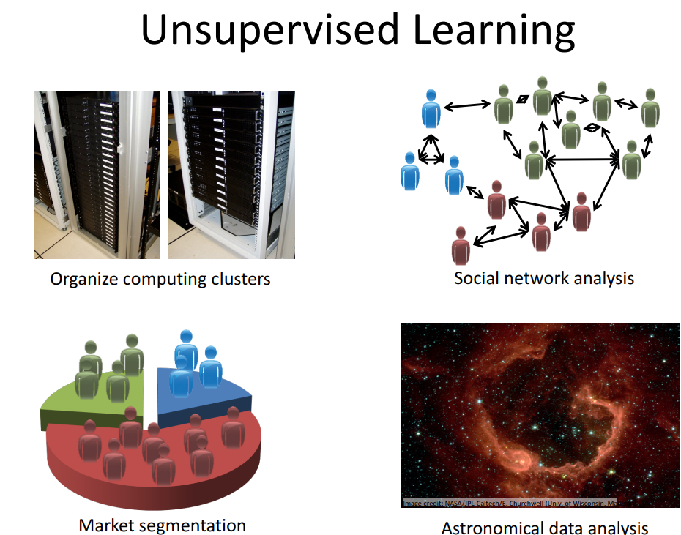
Machine learning:

Slide 18
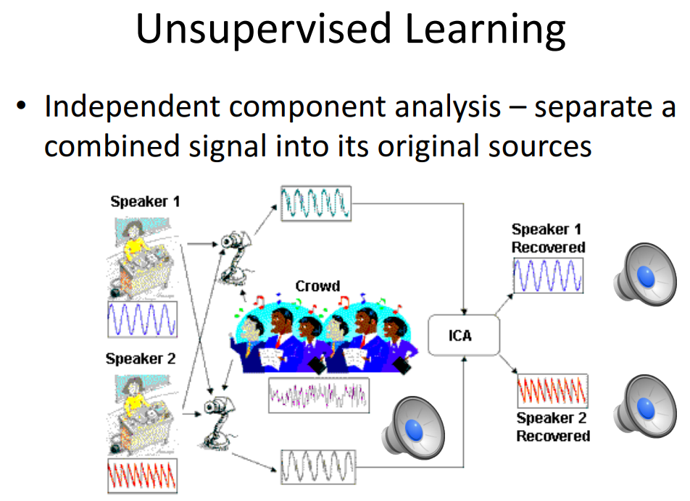
Machine learning:

Slide 19
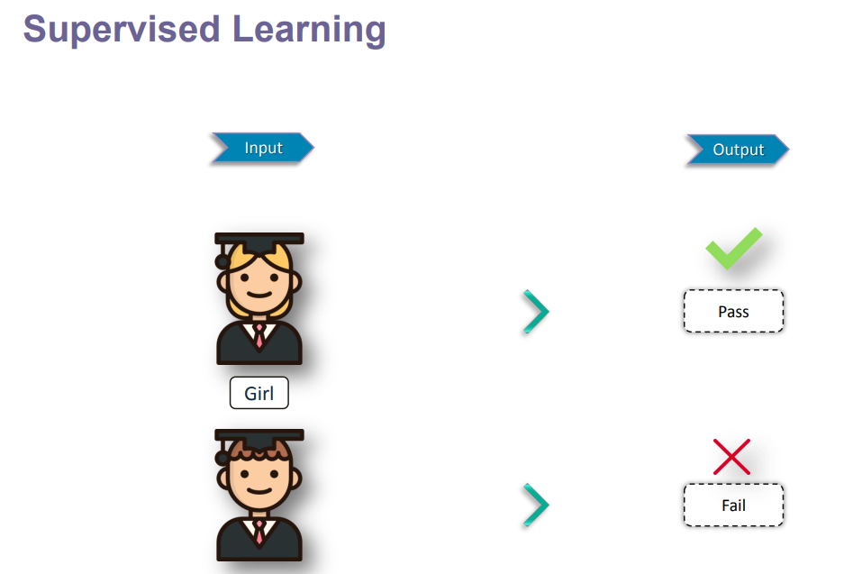
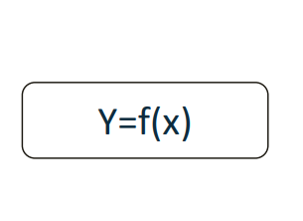
Machine learning:

Slide 20
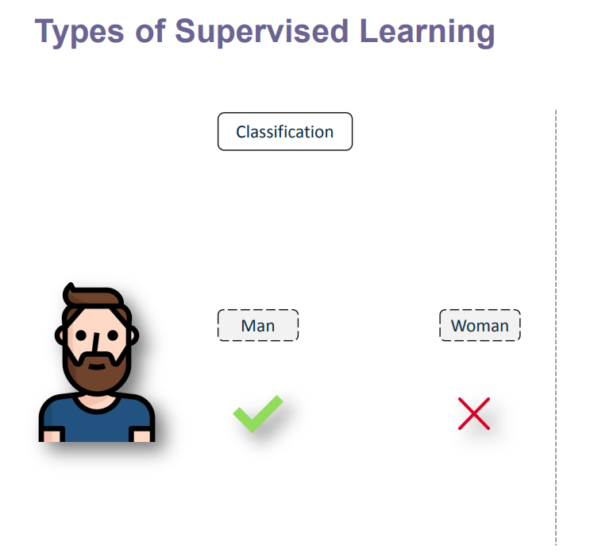
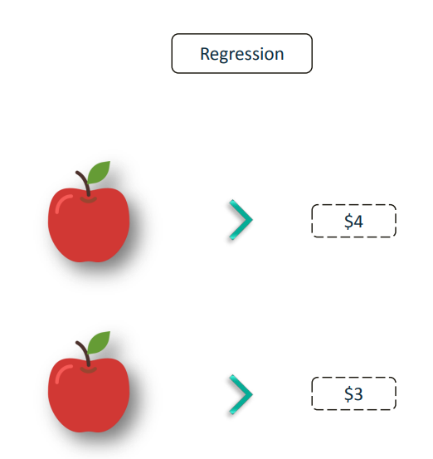
Machine learning:

Slide 21
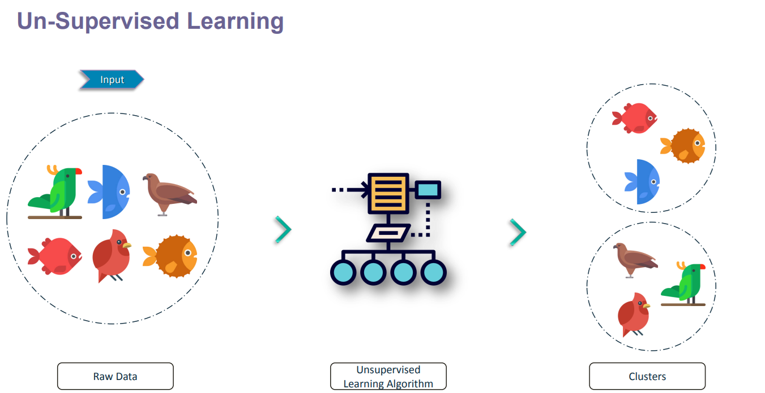
Machine learning:

Slide 22
How to frame good ML problem
Checklist:
Is there enough data? (Do you have sensor logs, labels, etc.)
Is the output predictable from the input?
Is there value in making this prediction?
Structure:
"Given [inputs], predict [output] to [achieve goal]."
✅ Examples:
“Given temperature, vibration, and voltage data, predict motor failure to reduce downtime.”
“Given product images, classify defects to automate quality control.”
✅ Exercise: Take the problem they discussed in groups and now write it in the format above.

Slide 23
Use Case | ML Type | Input | Output | Impact
Quality Control | Classification | Images, sensor data | Defect (Yes/No) | Improved product consistency
Predictive Maintenance | Forecasting | Vibration, temperature | Time to failure | Reduced downtime
Process Optimization | Reinforcement | Process parameters | Optimal setting | Increased yield
Supply Chain | Clustering | Usage data, delay logs | Route/inventory plan | Cost savings
Energy Management | Regression | Machine usage | Energy prediction | Cost optimization
Demand Forecasting | Time Series | Sales history | Predicted demand | Balanced production

